Slide 1

What AI/ML can and cannot do
ML & AI FOR LIFE SCIENCES 2026 · DAY 1 · LECTURE 1
…and how to look at your data first: PCA & UMAP
Trần Thượng Vân Du · SIB Swiss Institute of Bioinformatics
VNUHCM-University of Science · 02/11/2026
Notes:
~1 min. Welcome. This lecture: 35 min, then Colab practical on data exploration. Slides are in English; key terms also appear in Vietnamese on each slide (VI pill).

Slide 2
Three days, one question: what can the data tell us?
ROADMAP
VI: lộ trình
DAY 1 · FOUNDATIONS
DAY 2 · MORE POWER
DAY 3 · RESPONSIBILITY
Capabilities, limits; PCA & UMAP ← now
Unsupervised learning
Linear regression
Logistic regression & trees
Random forest & XGBoost
Neural networks, autoencoders, CNN
LLMs as research assistants
AI ethics: fairness, privacy, bias
Capstone in mixed teams
Presentations & feedback
Notes:
~1 min. Show the arc. Mention mixed pairs (biology + CS background) for all Colab sessions and the capstone. Each day ends with something you can use on your own data.

Slide 3
Biology now produces more data than people can read
WHY NOW?
VI: dữ liệu lớn
~$100M → <$1,000
200M+
~500,000
Predicted protein structures in the AlphaFold database
UK Biobank participants with whole-genome sequences
Cost of sequencing one human genome, 2001 → today
Sources: NHGRI sequencing cost data; AlphaFold DB (EMBL-EBI); UK Biobank WGS release 2023
Notes:
~1.5 min. Three numbers, no more. Message: data volume outgrew manual analysis; ML is the tool for finding patterns at this scale. Ask: who here has a dataset with more than 1,000 features?

Slide 4
AI, ML, deep learning: nested ideas
VOCABULARY
VI: trí tuệ nhân tạo · học máy · học sâu
AI
AI — any system that performs tasks we associate with intelligence (rules included)
ML
ML — systems that learn the rules from data instead of being given them
Deep learning
Deep learning — ML with many-layered neural networks (Day 2)
Foundation models, LLMs
Foundation models — very large models pre-trained on huge data, then adapted (AlphaFold, ESM, ChatGPT, Claude)
Notes:
~1.5 min. Most of Day 1 lives in the "ML" ring: classical methods that still win on many biological tables. Deep learning and LLMs come on Day 2.

Slide 5


Programming writes the rules; ML learns them
THE CORE IDEA
VI: mô hình học từ dữ liệu
Classic program
Rules
+
Data
Answers
Machine learning
Data
+
Answers (labels)
Rules = a model
Then we apply the learned model to new samples. The only question that matters: does it work on data it has never seen?
Notes:
~1.5 min. Example: a rule written by an expert ("if HbA1c ≥ 6.5% then diabetes") vs a rule learned from 10,000 patients. Plant the seed of generalisation: we will repeat "new data" all workshop.

Slide 6
Every ML problem has a Task, Experience and Performance
A DEFINITION YOU CAN USE
VI: nhiệm vụ · kinh nghiệm · hiệu năng
T
E
P
Task
Experience
Performance
What should the model do?
Find splice sites in a genome sequence
What data does it learn from?
Sequences with known, annotated splice sites
How do we measure success?
% of true splice sites found in held-out chromosomes
Notes:
~1.5 min. Quick exercise (30 s, pairs): write T, E, P for your own research question. Reuse this frame for the capstone proposal.

Slide 7
Almost everything this week is one matrix X and a label y
SHARED LANGUAGE · BIOLOGY ⇄ CS
VI: ma trận dữ liệu · mẫu · đặc trưng · nhãn
sample | TP53 | ESR1 | … | MYC | y
patient_01 | 812 | 3 | … | 240 | ER−
patient_02 | 655 | 4120 | … | 98 | ER+
patient_03 | 903 | 2875 | … | 131 | ER+
… | … | … | … | … | …
Row = sample: a patient, a cell, a tissue biopsy
Column = feature: a gene, a CpG site, a metabolite
Value often = read counts: skewed, so we log-transform and normalise for sequencing depth
y = label: what we want to predict (may be absent)
n rows (samples) × p columns (features) + one label column
Notes:
~2 min. For CS participants: a count is the number of sequencing reads mapped to a gene; deeper sequencing gives bigger numbers, hence normalisation. For biology participants: in ML language your "variables" are "features" and your "outcome" is the "label" or "target". Note: in omics p (20,000 genes) is usually much larger than n (100 patients).

Slide 8
Four ways a machine can learn
MAP OF THE FIELD
VI: có giám sát · không giám sát · tăng cường
Type | Question it answers | Biology example | In this workshop
Unsupervised | What structure is hidden in X? | Cell types in scRNA-seq | L1–L2 today
Supervised | Given X, predict a known y | Tumour subtype from expression | L3–L5
Self-supervised | Predict a hidden part of the data itself | Protein language models (ESM) | Day 2: DL, LLMs
Reinforcement | Which action maximises reward? | Molecule design loops | Mention only
Rule of thumb: no label → unsupervised; label → supervised. Number label → regression; class label → classification.
Notes:
~1.5 min. Self-supervised is how foundation models are trained: mask a word, an amino acid or a gene and predict it. No human labels needed.

Slide 9
What ML does well
PART 2
Four results that changed how biology is done
Notes:
Transition. ~10 s.

Slide 10
ML already solves real problems in life science
CAPABILITIES
VI: năng lực của AI
Protein structure
Variant interpretation
AlphaFold 2 predicts 3D structure from sequence at near-experimental accuracy; Nobel Prize in Chemistry 2024.
AlphaMissense scores all ~71 million possible human missense variants as likely benign or pathogenic.
Digital pathology
Single-cell atlases
Deep learning predicts microsatellite instability in colorectal cancer directly from H&E slides.
Automatic cell-type annotation (e.g. CellTypist, scVI) across millions of cells and many studies.
Notes:
~2 min. Common thread: lots of high-quality labelled data (PDB, ClinVar, TCGA slides, cell atlases) and a clear, measurable task. Ask: which of these would help in your lab?

Slide 11
ML shines when four conditions hold
WHEN TO USE ML
VI: khi nào nên dùng học máy?
Good fit
Poor fit
Many examples, reliably labelled
The pattern is stable over time and sites
Prediction is the goal, not mechanism
Errors are cheap to check downstream
30 samples, 20,000 features
Training data from one hospital or one batch
You need a causal answer ("does X cause Y?")
A wrong answer harms a patient directly
Notes:
~1.5 min. Poor fit does not mean "never"; it means "be careful, use simple models, validate externally". Skip-if-late candidate.

Slide 12
…and where it fails
PART 3
A model learns whatever pattern predicts best, including the wrong ones
Notes:
Transition. ~10 s.

Slide 13

A model learned that asthma lowers pneumonia death risk
LIMIT 1 · CORRELATION IS NOT CAUSATION
VI: tương quan ≠ nhân quả
Asthma
Sent to ICU
Lower death
In the training data, asthmatic pneumonia patients were treated more aggressively, so they died less. The pattern was real; the conclusion "send asthmatics home" would be deadly.
Prediction ≠ explanation. Coefficients and feature importances describe the data, not the biology.
Caruana et al. KDD 2015 (pneumonia risk models)
Notes:
~2 min. Ask first: "Does asthma protect from pneumonia death?" Let them guess, then reveal the treatment pathway. Link to Day 3 ethics.

Slide 14
COVID-19 X-ray models learned the hospital, not the lungs
LIMIT 2 · SHORTCUTS & DISTRIBUTION SHIFT
VI: học đường tắt · dịch chuyển phân phối
Positive and negative images came from different sources. Models used text markers, patient position and image borders: features that told them the source, not the disease.
The same trap in omics
Cases sequenced in 2023, controls in 2024
Tumours from hospital A, normals from B
One lab's protocol for one subtype
Accuracy was high inside the dataset and dropped sharply on images from new hospitals.
The model will learn the batch.
DeGrave, Janizek & Lee, Nat Mach Intell 2021 · Zech et al. PLoS Med 2018
Notes:
~2 min. Key phrase: "distribution shift" = new data differs from training data. External validation (another cohort, another hospital) is the only real test. Bridge to PCA: we will use PCA to detect batch effects before modelling.

Slide 15
Eight reasons textbook ML breaks on biology
LIMIT 3 · BIOLOGICAL DATA IS DIFFERENT
VI: đặc thù dữ liệu sinh học
p ≫ n
Batch effects
Confounders
Replicates
20,000 genes, 80 patients
Date, lab, kit, operator
Age, sex, BMI, medication
Technical ≠ biological
Grouped samples
Imbalance
Noisy labels
Odd distributions
Many cells or visits per patient
Rare disease: 1 case in 100
Pathologists disagree
Sparse counts, compositional microbiome
These matter more than the choice of algorithm.
Notes:
~2.5 min. Ask biology participants to explain one tile to the room each (e.g. technical vs biological replicate). This is the moment the two groups teach each other. "Grouped samples" = later we split by patient, never by cell or by visit.

Slide 16
A model is never better than its data and its question.
GARBAGE IN, GARBAGE OUT
So before any model: look at the data.
Notes:
~30 s. Pause here. This is the bridge to exploratory data analysis.

Slide 17
Exploring data with PCA & UMAP
PART 4
Seeing 20,000 dimensions on a 2D screen
Notes:
Transition. ~10 s.

Slide 18
Six checks before any model
EXPLORATORY DATA ANALYSIS
VI: phân tích khám phá dữ liệu (EDA)
1 · Size
2 · Missing values
3 · Distributions
How many samples per group? Per batch?
Where, how many, and missing why?
Skewed? Needs log? Zeros?
4 · Scale
5 · Outliers
6 · Metadata
Features in very different units?
Biology or a failed sample?
Colour every plot by batch, site, sex, date
Notes:
~1.5 min. Check 6 is the one people skip. In Colab you will do all six on the practice dataset before running PCA.

Slide 19
With 20,000 genes, every sample is far from every other
CURSE OF DIMENSIONALITY
VI: lời nguyền số chiều
20,000
We cannot plot 20,000 axes.
In high dimensions, distances become similar and noise dominates.
features (genes)
100
But genes are correlated: pathways move together. The real information lives in far fewer dimensions.
Dimensionality reduction finds those few dimensions.
samples (patients)
Notes:
~1.5 min. VI: giảm chiều dữ liệu. Analogy: a shadow of a 3D object on the wall is a 2D projection; a good angle keeps the shape recognisable.

Slide 20
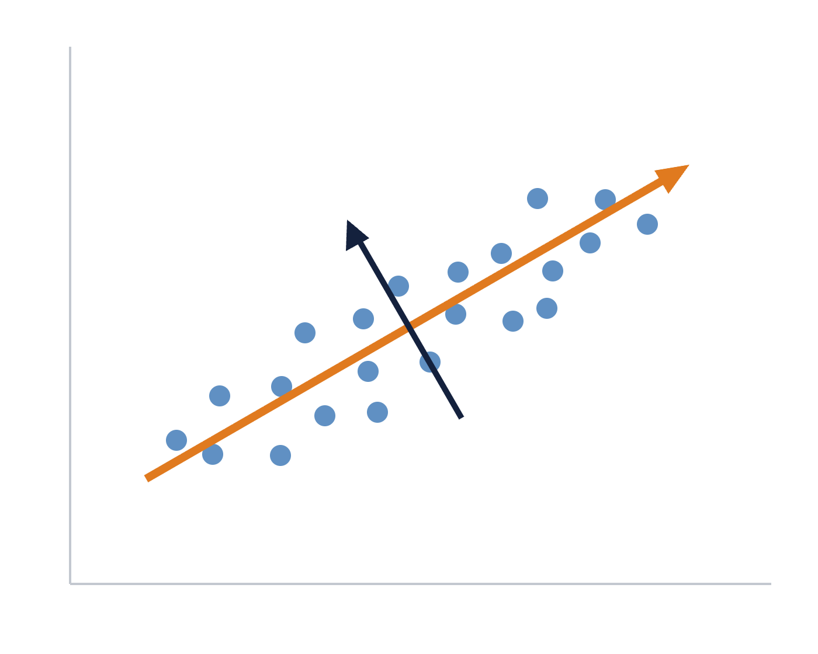
PCA rotates the axes to follow the spread of the data
PCA · THE INTUITION
VI: phân tích thành phần chính
PC1
PC1 = the direction of largest variance: a weighted mix of all genes.
PC2
PC2 = the next largest, at right angles to PC1. And so on.
Keep the first few PCs → most of the signal in 2–50 dimensions instead of 20,000.
Linear, deterministic, fast. Always centre (and usually scale) features first.
gene A
Notes:
~2 min. Use your hands: hold a pen along the long axis of the cloud = PC1. For CS participants: PCs are eigenvectors of the covariance matrix (or from SVD of the centred X). Biology participants do not need the linear algebra.

Slide 21

Three outputs, three questions
PCA · READING THE OUTPUT
VI: điểm số · phương sai giải thích · hệ số tải
Scores
Explained variance
Loadings
Where is each sample?
How much does each PC keep?
Which genes drive a PC?
The PC1 vs PC2 scatter plot. Colour by every metadata column: groups, outliers, batches.
Top-weighted genes of PC1 → pathway enrichment → a biological name for the axis.
Scree plot: keep PCs before the "elbow".
Notes:
~2 min. Loadings are where biology participants add the most value: they can recognise "this PC is proliferation" or "this PC is immune infiltration". A PC explaining 40% of variance is not automatically the interesting one.

Slide 22
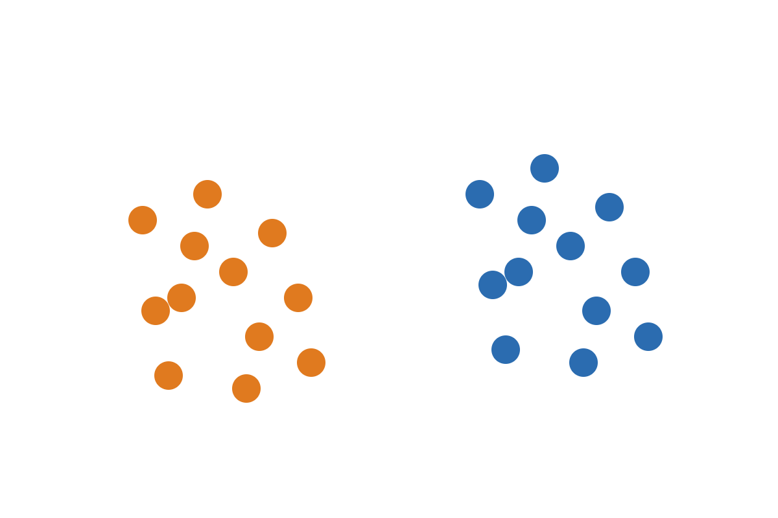
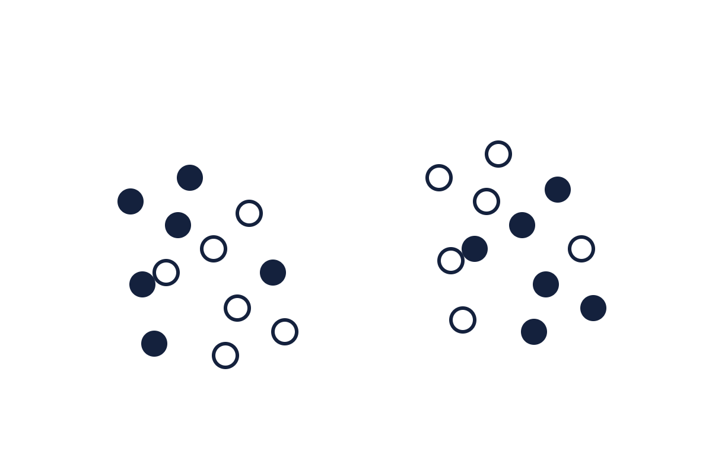
Same PCA plot, two colourings: which one explains PC1?
PCA AS A QUALITY-CONTROL TOOL
VI: hiệu ứng lô (batch effect)
Coloured by sequencing batch
Coloured by disease status
Orange = batch 1 · blue = batch 2 · clear split
Filled = disease · hollow = control · no split
PC1 = batch, not biology. Fix the design or correct the batch before any modelling.
Notes:
~2 min. Poll first: show only the left plot and ask "two subtypes?" Then reveal the colouring. Remedies: balanced design (best), include batch as a covariate, or correct with ComBat / Harmony, carefully, never letting the outcome leak into the correction.

Slide 23
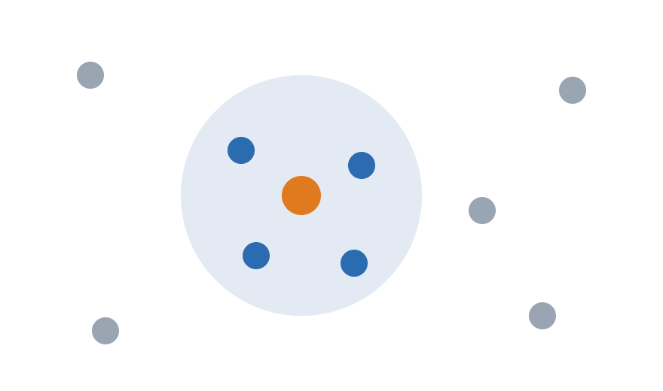
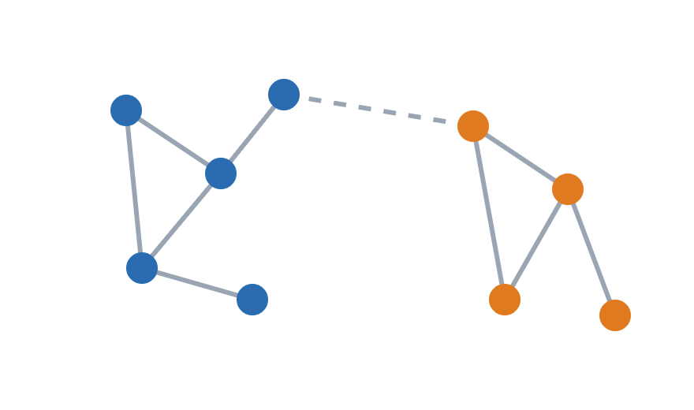

UMAP keeps neighbours together, and only neighbours
UMAP · THE INTUITION
VI: láng giềng gần nhất · đồ thị
1 · Find neighbours
2 · Build a graph
3 · Lay it out in 2D
For each cell, its k nearest cells in the high-dimensional space (often in PCA space).
Connect neighbours; strong edges for close cells, weak edges for far ones.
Move points in 2D until the 2D graph looks like the original graph.
Notes:
~2 min. t-SNE works on the same principle (local neighbourhoods); UMAP is faster and is the default in Scanpy and Seurat. Non-linear: it can unfold curved structures that PCA flattens.

Slide 24
A UMAP is a map of neighbourhoods, not of distances
UMAP · READ WITH CARE
VI: diễn giải cẩn thận
You can read
You cannot read
Knobs that change it
Which samples are local neighbours
That groups probably exist (then verify)
Where a marker gene or a batch sits
Distances between clusters
Cluster size or density
Meaning of the axes
n_neighbors: local ↔ global
min_dist: how tightly packed
Random seed
Rule: explore with UMAP, conclude with statistics.
Notes:
~2 min. Demo idea in Colab: rerun UMAP with n_neighbors = 5, 15, 50 and two seeds; watch clusters move and change size while the neighbourhoods stay.

Slide 25
PCA and UMAP answer different questions
SUMMARY
VI: so sánh PCA và UMAP
 | PCA | UMAP
Type | Linear | Non-linear
Same result every run? | Yes | No (seed, parameters)
Axes mean something? | Yes: % variance, loadings | No
Preserves | Global structure | Local neighbourhoods
Best for | QC, batch, input to models | Visualising groups, e.g. cell types
In practice you use both: PCA first, then UMAP on the top PCs.
Notes:
~1 min. Skip-if-late: the table repeats the previous slides; can be shown briefly.

Slide 26
Three things to remember
TAKE-AWAYS → COLAB
1
2
3
ML learns patterns, including batch effects and shortcuts.
The real test is always new, independent data.
Look first: PCA for structure and QC, UMAP for neighbourhoods.
Notes:
~1 min. Hand over to Colab. Pairs prepared from the Python test results. Walk around; ask each pair what PC1 means in their plot.

